Slide 1
Control Flow Attestation in the Internet of Things (IoT)
2019
Based on work of A. Paverd, N. Asokan, Lucas Davi

Slide 2
Outline
Introduction to attestation in IoT
Control Flow Attestation

Slide 3
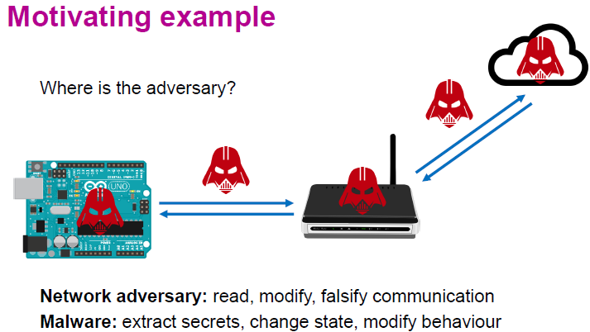
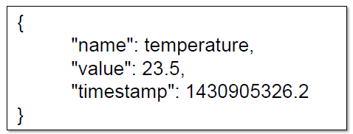
Example of IoT Security
A wireless sensor network collects temperature
data periodically and sends it to the cloud
Our focus: detecting malware on the IoT node

Slide 4
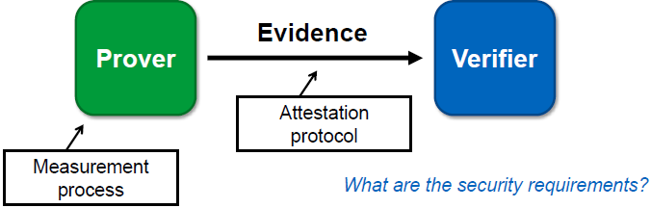
Remote Attestation
integrity evaluation done by a remote verifier to check whether a system can accomplish its tasks as expected
Integrity is the expectation that a system/application behaves as defined by the developer
An interaction between two parties through which the resource-rich verifier (e.g., the base station or gateway) ascertains the current state and/or behaviour of the resource-constrained prover (e.g., the IoT node).

Slide 5
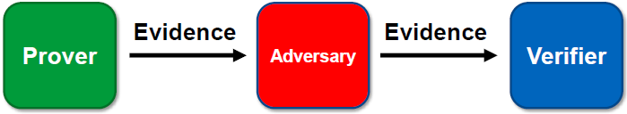
Attestation Requirements
1.Authenticity
representation of the real state of the system
2. Timeliness
representation of the current state
In the presence of adversaries

Slide 6
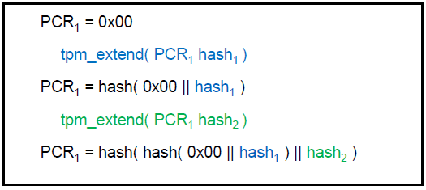
Trusted Platform Module (TPM)
TPM Platform Configuration Registers (PCRs)
store cryptographic hash
cannot be over-written; only extended

Slide 7
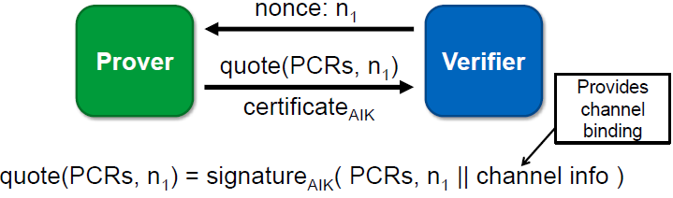
TPM Quote
PCR values signed by TPM-bound Attestation Identity Key (AIK)
includes nonce to ensure timeliness
Attestation: a correct quote verifies the authenticity of the prover

Slide 8
IoT Attestation Challenges
TPM Attestation Limitations
Covers only the initial loading of software
Deals with only one prover and one verifier
“Decision of trustworthiness” does not scale
measurements change with every software update
Small IoT node does not have TPM!
Additional hardware takes up space, uses power, and increases hardware cost (TPM + integration)
Additional software requires driver and software library

Slide 9
Attestation of Things (AoT)
Software-based attestation
Hybrid attestation
Scalability of attestation
Run-time attestation

Slide 10
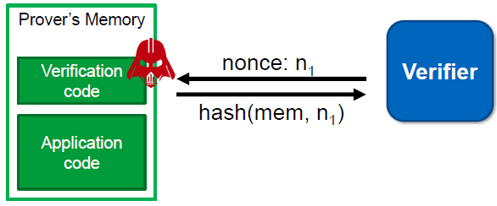
Software-based Attestation
Assumes no hardware features to support attestation
No secrets on prover (e.g. no AIK)
Cannot guarantee specific code being run

Slide 11
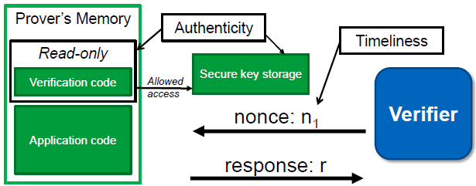
Hybrid Attestation
Small changes to hardware to provide read-only verification code, secure key storage and atomicity of execution of Verification code
Minimal trust anchors
e.g., TrustZone-M (ARM v8)
Benefits
Can be used across a network / over an untrusted channel
Verifier need not know prover’s exact hardware configuration

Slide 12
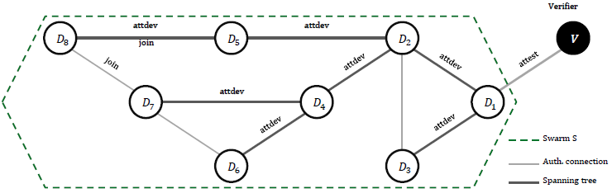
Scalability Issues
Attestation protocols usually assume a single prover
but IoT scenarios may involve groups of (many) provers
Device swarms
dynamic topology: nodes move within swarm
dynamic membership: nodes join and leave the swarm
Details in
N. Asokan, F. Brasser, A. Ibrahim, A.-R. Sadeghi, M. Schunter, G. Tsudik, and C. Wachsmann. SEDA: Scalable Embedded Device Attestation. ACM CCS 2015

Slide 13
Outline
Introduction to attestation in IoT
Control flow attestation

Slide 14
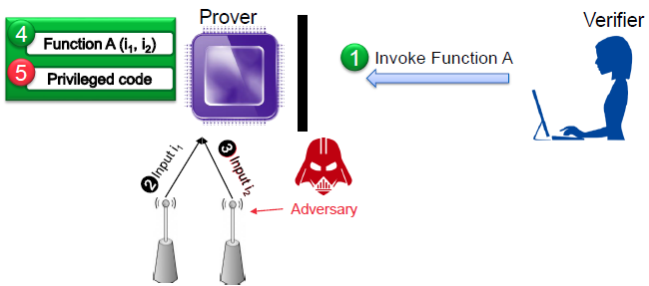
Runtime Attestation
Traditional attestation measures binaries at load time
Cannot capture run-time attacks
Return-oriented programming
Control flow attacks

Slide 15

Control Flow Hijack Attacks
Attacker modifies code pointer
Function return
Indirect jump
Indirect call
Control-flow leaves valid CFG, and
Code injection: jumps to malicious code
Code reuse: reuse existing code snippets to form malicious code
Return-oriented programming
Jump-oriented programming
1
Attacker
2 3
4
4'
Malicious code

Slide 16
Control Flow Integrity (CFI)
Compiler constructs CFG statically
Find set of allowed targets for each call site
Runtime enforcement to CFG with online set check
Code pointers verified when used
Forward edge: virtual function calls, function pointers
Backward edge: function returns
…
jmpl *%eax
…
call *(0xb)
…
call *(0xc) call *4(0xc)
0xa 0xb 0xc 0xd
0xd 0xe
0x2 0xf
Notes:
defenses against control-flow hijacking
include: control-flow integrity (CFI) [1], fine-grained code
randomization [13, 27], and code-pointer integrity (CPI) [26].

Slide 17
CFI
CHECK and CHECK_RET instructions are inserted to check for legal target sites (red arrows)
CHECK(fn);
(*fn)(x);
CHECK_RET();
return 7;

Slide 18










CFI Example
sort2(int a[], int b[], int len)
{
sort(a, len, lt);
sort(b, len, gt);
}
bool lt(int x, int y) {
return x<y;
}
bool gt(int x, int y) { return x>y;
}
sort2
lt
sort
gt
Which functions call other functions
sort2
lt
sort
gt
Break into basic blocks, distinguish calls from returns
Only consider Indirect transfers (call via register, or ret)

Slide 19











Coarse-Grained Labeling
sort2
label L
lt
sort
label L
label L
label L
label L
gt
ok…
system
Use the same label at all targets
Blocks return to the start of direct-only call targets but not incorrect ones

Slide 20

Fine-Grained Labeling
sort2
label M
lt
sort
label L
label N
label L
label M
gt
ok…
Constraints:
•
•
•
return sites from calls to sort must share a label (L) call targets gt and lt must share a label (M) remaining label unconstrained (N)
Still permits call from site A to return to site B

Slide 21
Existing CFI Mechanisms
Fine-grained CFI (precise, requires source code)
Lockdown (DIMVA'15)
MCFI and piCFI (PLDI'14 and CCS'15)
Google LLVM-CFI
Google IFCC (Usenix SEC'14)
Coarse-grained CFI (imprecise, e.g., Microsoft’s Control Flow )
MS Control-Flow Guard
CFI techniques do not perform control flow attestation
They only report whether a control-flow attack occurred (program control flow deviates from the CFG), but provide no information about the actually executed control-flow path (program control flow follows the CFG, but code-reuse attack has occurred)
Notes:
Many others
Minimize target sites

Slide 22
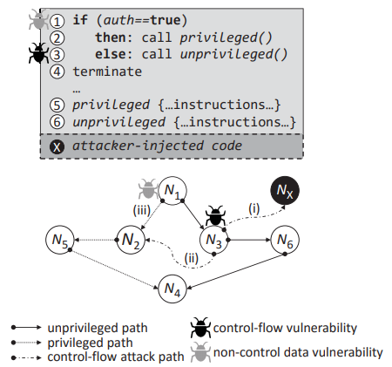
Runtime Attacks
The program that calls either a privileged or non-privileged subroutine based on the authentication variable auth.
Non-control data vulnerability at node N1: the attacker can change auth from false to true, so that execution continues in the privileged path (iii), although the user has not been authenticated to execute that path.
Control-flow vulnerability at node N3: allows the attacker to overwrite code pointers that store control-flow information. (Typically, these vulnerabilities allow the attacker to read from, and write to, the application’s memory.) Upon encountering the corrupted code pointer, the program’s control flow is deviated to either (i) previously injected code (node NX) or (ii) existing code (node N2) such as system functions or unintended code sequences. The latter is commonly referred to as code-reuse attack, or return-oriented programming, which cannot be thwarted by data execution prevention (DEP) for preventing code injection attacks by either marking memory as writable or executable.
CFI techniques cannot detect attacks (ii) and (iii).

Slide 23
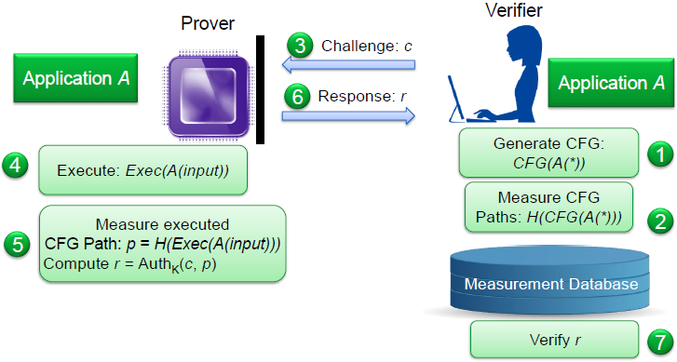
Control-Flow Attestation (C-FLAT)

Slide 24
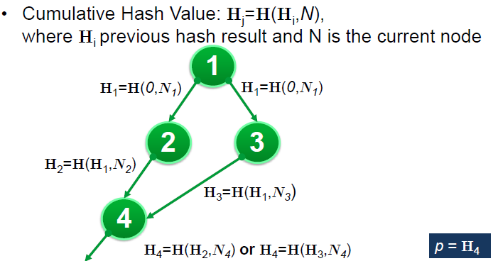
C-FLAT
Verifier knows which path has been followed from the cumulative hash value

Slide 25
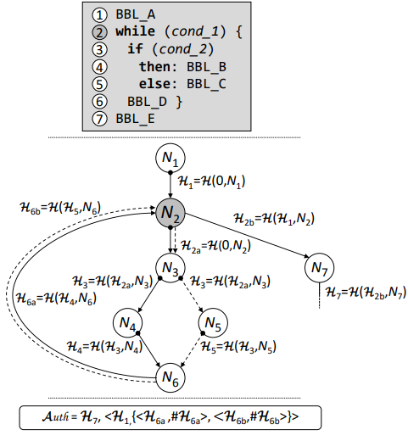
C-FLAT Loop Handling
We measure each loop execution separately and merge its cumulative value with that of the previous execution, at loop exit.
Consider the example in Figure 4: We initiate a new computation when the loop is entered, i.e., H2a = H(0, N2). To avoid losing the previous value, we store H1.
The if-else statement within the loop diverts control flow at N3 to either N4 or N5, depending on cond_2. Consequently, each loop iteration can either output H6a (solid line) or H6b (dashed line).
Upon loop exit, it is also desirable to attest the number of times a loop is executed. To do so, we track each loop measurement separately, by storing the number of times a distinct measurement was encountered at N2, and including this result #H6a, #H6b in Auth where #Hi reflects the number of loop iterations for each possible path. This ensures that every loop iteration is attested. However, the size of Auth is now expanded by the number of different paths inside the loop.

Slide 26
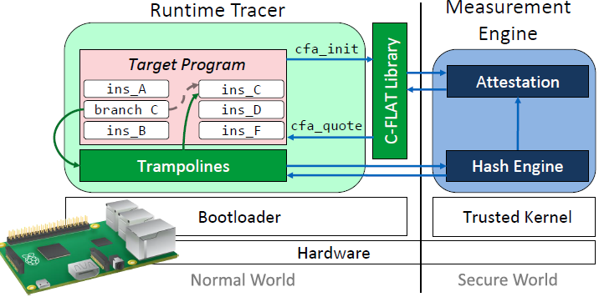
Proof-of-Concept Implementation
Bare-metal prototype on Raspberry Pi 2
Single-purpose program instrumented using binary-rewriting
Runtime Monitor written in ARM assembler
Measurement Engine isolated in TrustZone-A Secure World

Slide 27
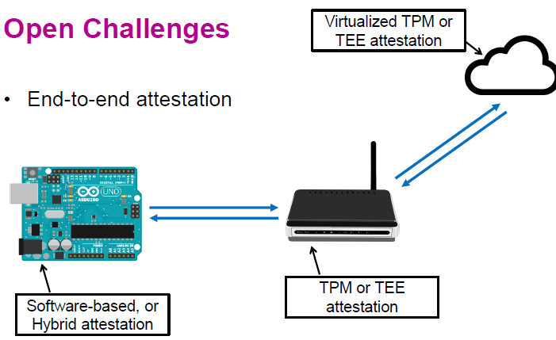
End-to-End Attestation

Slide 28
Abuse of Attestation: Bad Verifier
Attestation protocols usually consider a benign verifier
But adversary could impersonate verifier to abuse attestation
e.g., computing a MAC over all memory in a typical microcontroller could take ~ 750 ms
may be used for denial of service (DoS) attack

Slide 29
Counter-Measures to Bad Verifier
Verifier must be authenticated to prover
but asymmetric crypto is computationally expensive
Prover must detect replays of previous requests
can use nonces, or counters, or timestamps
Nonces require integrity-protected storage for previous nonces
Counters require minimal integrity-protected storage for counter
Timestamps require trusted synchronized clock at prover side

